Slide 1
Creating Classes part 2
Barb Ericson
Georgia Institute of Technology
June 2006

Slide 2
Learning Goals
Computing concepts
  Declaring a constructor
  Overloading constructors
    Adding a no-argument constructor
  Using a debugger to step through execution
    How to start the debugger
    How to set a breakpoint
    How to check the value of a variable or field

Slide 3
Constructors
Are used to initialize the fields of an object
  To other than the default values or assigned values
You can have more than one constructor
  As long as the parameter lists are different
  This is called overloading constructors
Syntax
  visibility ClassName(paramList) {}
Example
  public SlideShow(Picture[] pictArray)
  {
  this.pictureArray = pictArray;
  }

Slide 4
Creating 1D Arrays
You can declare an array using
  Type[] arrayName;
You can create an array using
  new Type[size];
You can declare an array and create it at the same time
  Type[] arrayName = new Type[size];
Array indices start at 0 and end at length – 1
You can get the length of an array using
  arrayName.length
You can add an element to an array using
  name[index] = Object;

Slide 5
Add a Constructor
Add the following after the field declarations to SlideShow.java:
  public SlideShow(Picture[] pictArray)
  {
  this.pictureArray = pictArray;
  }
Compile and test
  SlideShow showObj = new SlideShow();
Notes:
You can leave off the ‘this.’ on ‘this.name’ and the compiler will add it for you.

Slide 6
Why did you get an Error?
We hadn’t declared any constructors before we added this one
  But a constructor is called each time a new object is created
  We didn’t provide one so the compiler added a no-argument constructor
    One that takes no parameters and leaves the fields with their default or assigned values
But once you add a constructor
  The compiler will not add any for you
    So now you get an error when you try to use a no-argument constructor

Slide 7
Adding a No-Argument Constructor
Add the following constructor to the Student class
  public SlideShow() {}
Now test it again with:
  SlideShow showObj = new SlideShow();
  System.out.println(showObj);
Also try:
  Picture[] pictArray = new Picture[5];
  pictArray[0] = new Picture(FileChooser.getMediaPath("beach.jpg"));
  pictArray[1] = new Picture(FileChooser.getMediaPath("blueShrub.jpg"));
  pictArray[2] = new Picture(FileChooser.getMediaPath("church.jpg"));
  pictArray[3] = new Picture(FileChooser.getMediaPath("eiffel.jpg"));
  pictArray[4] = new Picture(FileChooser.getMediaPath("greece.jpg"));
  SlideShow vacShow = new SlideShow(pictArray);
  System.out.println(vacShow);
Notes:
When we create student1 the no-argument constructor will be called since we haven’t passed any parameters. When we create student2 the constructor will be called that takes a string.

Slide 8
Tracing Execution
One way to trace what is happening in your program is
  To add System.out.println() statements
Add these to print out the value of the picture array both before and after it is set
  System.out.println(this.pictureArray);
  this.pictureArray = pictArray;
  System.out.println(this.pictureArray);

Slide 9
Debuggers
You can use a debugger to find the cause of bugs (errors in your program)
  A moth caused one bug
  http://www.jamesshuggins.com/h/tek1/first_computer_bug.htm
And to trace execution to see what is happening
  Which constructor is executed or what method is executed
  What values are in the fields

Slide 10
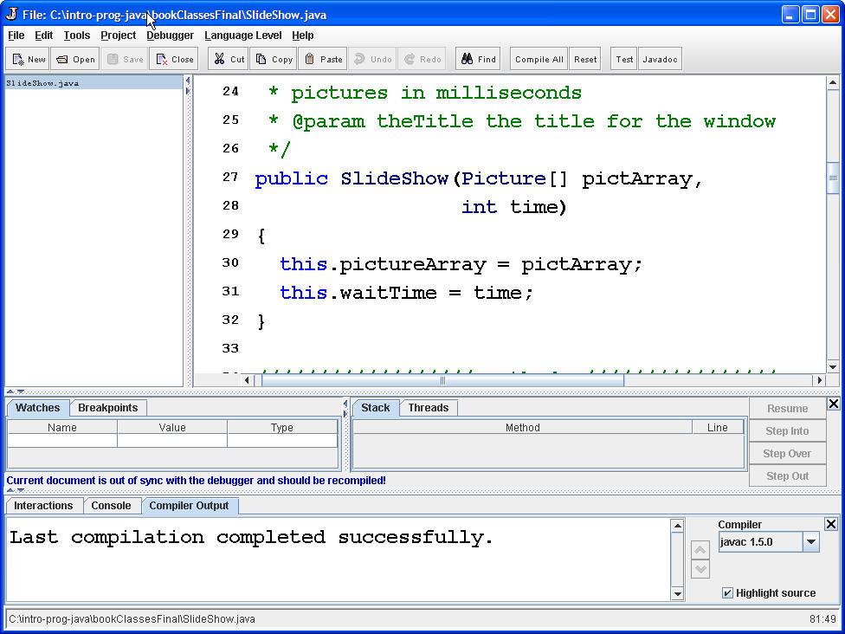
DrJava’s Debugger
Click on Debugger in the menu
  Then check the Debug Mode checkbox
Stack and
Threads
Area
Watches
and
Breakpoints
Area
Check values here

Slide 11
Setting a Breakpoint
When you use a debugger you often want to set places to stop execution
  Each place to stop at is a breakpoint
Once execution has stopped there
  You can check the value of parameters and fields
To set a breakpoint
  Right click on a line of code
  Pick “Toggle Breakpoint”
  It will be highlighted in red
Notes:
All debuggers let you set breakpoints.

Slide 12
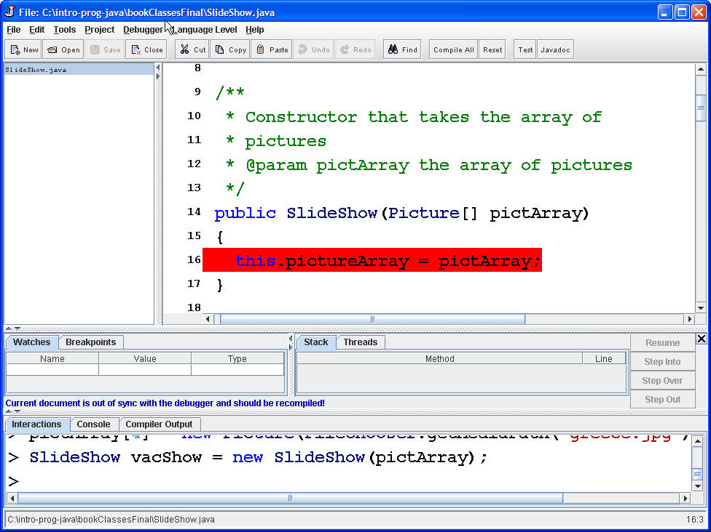
Showing a Breakpoint
Lines with breakpoints are highlighted in red in DrJava
Set a breakpoint at the line that sets the picture array

Slide 13
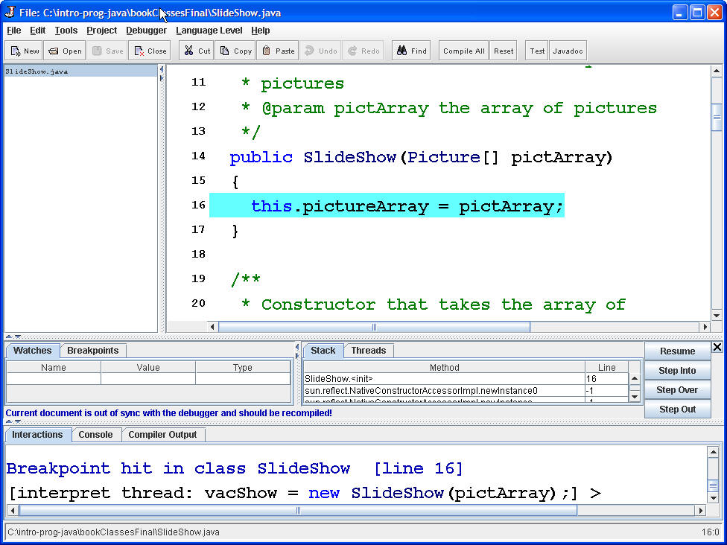
Testing a Breakpoint
Try the constructor again that takes an array of pictures
Execution should stop at the breakpoint
  And the color will change to blue

Slide 14
Checking Values
Execution stops before the breakpoint line is executed
  So the array hasn't been set yet
  Check this by printing out the value of it in the interactions pane
    this.pictureArray
  Then click on the Step Over button
    To let the current line of code be executed
  And check the values again
Notes:
Remember that in DrJava if you type something without a semicolon at the end it will print the value of the expression.

Slide 15
Debugging Options
Step Over
  Execute the current line of code and then stop again before you execute the next line of code
Step Into
  If the line of code that we are stopped at has a method call in it stop at the first line in the called method
Resume
  Continue execution at the current point
    Until the next breakpoint
    Or the program ends
Step Out
  Execute the rest of the current method and stop at the first line after the call to this method
You can quit debugging by clicking on the X

Slide 16
Adding a Constructor Exercise
Create another constructor in the SlideShow class
  That takes both the array of pictures and the time to wait between pictures
    public SlideShow(Picture[] pictArray,
    int time)
  Use the debugger to check what happens during execution of this constructor

Slide 17
Summary
Constructors initialize the fields in an object
To declare a constructor
  public ClassName(paramList) {}
    No return type
    Same name as the class
You can overload constructors
  The parameter lists must be different
Use a debugger
  To watch what happens during execution

